Slide 1
Sub-National Shelter & NFI Cluster Coordination meeting for C&S
1. Review of minutes of previous meeting
2. 2018 HNO / HRP Process
3. Western Anbar Influx Updates
4. Issues
a.) Pre Positioning for Anbar / Salah a Din (Updates)
b.) Available plots in Anbar Camps (latest version)
c.) Summer activities –Gap Analysis (latest version)
d.) Tent Replacement (Kilo 18, AAF camps etc.)
e.) Winterisation Plans (Partner assessments)
5. Governorate Updates
6. AoB
“Request for Expression of Interest” on IOM website:
https://www.iom.int/procurement-opportunities
Wednesday, 9th August 2017
http://sheltercluster.org/response/iraq

Slide 2
Current Cluster Team Structure – since 11 July 2017
Laurent de Valensart - UNHCR National Cluster Coordinator +964 (0) 771 994 5694 coord.iraq@sheltercluster.org Michel Tia - IOM Information Management Officer - National +964 (0) 750 021 1720 im2.iraq@sheltercluster.org Cornelius Weira - IOM Sub National Co-Chair - Centre and South +964 (0) 751 234 2548 coord4.iraq@sheltercluster.org Laurence West - UNHCR Sub National Coordinator – KRI +964 (0) 771 911 0574 coord3.iraq@sheltercluster.org | Andrea Quaden - NRC National Cluster Co-Coordinator +964 (0) 751 740 7635 coord2.iraq@sheltercluster.org Abdoulaye Dieye -NORCAP Information Management Officer - Assistant National +964 (0) 771 488 2672 im3.iraq@sheltercluster.org Tonja Klansek Roving Cluster Coordinator - ACTED +964 (0) 773 725 8092 coordroving.iraq@sheltercluster.org Ali Rasul – UNHCR Senior Cluster Associate +964 (0) 750 445 4684 snrnatassot.iraq@sheltercluster.org

Slide 3
1. Review of action points from previous meeting
Sub National Coordinator to share power point presentation of the MCNA IV findings with Partners - Done
UNHCR to share MODM figures on tent replacements and Summerisation activities – Pending
IOM to share copy of official letter of eviction of IDPs living in Al-Adhamiya Collective Center by the Baghdad Operations Command - Done.
Cluster to follow up with Protection Cluster on the various forced evictions cases happening in a number of Camps in Center and South - Done.
Sub National Coordinator to follow up with a number of Partners on Summer top up kits for the UNHCR CRI kit being provided to new arrivals from Western Anbar - Done
Sub National Coordinator to share latest 4Ws and Achievements as part of the cluster information products - Done
UNHCR to share GPS Coordinates for the shelter rehabilitation activities in Centre and South -Done

Slide 4
2018 HNO / HRP Process– What do we need in terms of IM support
2018 HNO/HRP timeline & process (including key components of HNO): ICCG ongoing process / Timeline been shared through mail on 6Aug.17
Very important: 1st – 20th August 2017: Collect & Compile Completed and Planned Assessments – Partners to share information on there Planned assessment (google link below) and the raw data & reports of Completed Assessment (iraq@sheltercluster.org)
For Planned Assessment, here is the google link to inform:
https://docs.google.com/spreadsheets/d/1XmVshKpVUtXNj7leAyyzpxdj6v5jkFvGkfF3fZr8UU4/edit#gid=0
18th August 2017: OCHA to share the Humanitarian Profile
18th – 23th August 2017: Clusters to share their Severity Map (indicators to develop – SAG approval)
28th August 2017: Cluster to share their PiN and mains graphics that highlight Cluster key issues

Slide 5
Western Anbar Influx Updates
Nadhira Screening Site (north of Rutba): UNHCR and partners began the installation of 10 shade areas 10km south of the checkpoint, where families wait for several hours before ISF escorts them to Kilo 160 CP then to Kilo 18 camp;
Kilo 60 Camp: remains closed.
Kilo 18 Camp: JCMC confirmed no expansion for this camp from MoMD side; UNHCR and partners are building two new sections with a total of 512 tents;
MoMD continues to relocate 100+ IDP families (approx. 600 individuals) from the camp to HTC and AAF whenever the camp is near full capacity;
A total of 1,059 families (approx. 6,354 individuals) have reportedly departed the camp during the month of July.
Planning Figures as of 7th August 2017:-
Estimated number of people remaining under ISIL Controlled areas - 70,000
Number of People displaced from Western Anbar since January 2017 – 38,000

Slide 6
4 a. )Key Issues – Prepositioning for Western Anbar Influx
UNHCR Stock - 2,000 tents prepositioned in Anbar
UNHCR Stock – 2,500 CRI Kits prepositioned in Anbar
IOM Stock - 1,000 NFI Kits being sent to Anbar ( Plus 2,000 Summer top up)
QRCS Stock - 279 Tents Prepositioned in Anbar
MODM stock - 100 tents Prepositioned in Anbar
Total Tents = 2,379
Total CRIs / NFI Kits = 3,500

Slide 7
4 b.) Key Issues - Available plots in Anbar Camps (latest version)
Currently there are approximately 7,000 available plots in existing Anbar Camps in HTC , AK and AAF.

Slide 8
4 c ,d, e.) Key Issues - Summer activities –Gap Analysis (latest version)
CRS recently distributed more than 2,110 Basic NFI kits with summer items in HTC camps
IOM is planning to transfer2,000 summer top up kits to Anbar . IOM Coordinating with UNHCR and CRS to avoid overlap
MODM has distributed 1,000 AWCs in HTC ( UNHCR to Confirm)
Current Gap about 5,000 HHs
Tents so far replaced 7,989 ; Current Gap 15, 011 needed for Camps in AAF, HTC and AK
Partners are requested to share winterization plans for consolidation .

Slide 9
5. Governorate Updates
Baghdad
Basrah
Kirkuk

Slide 10
6. AoB
Request for Expression of Interest” on IOM website: https://www.iom.int/procurement-opportunities
ToRs
Next meeting will be Wednesday 23rd August , 12:30 pm at RCC4

Slide 11
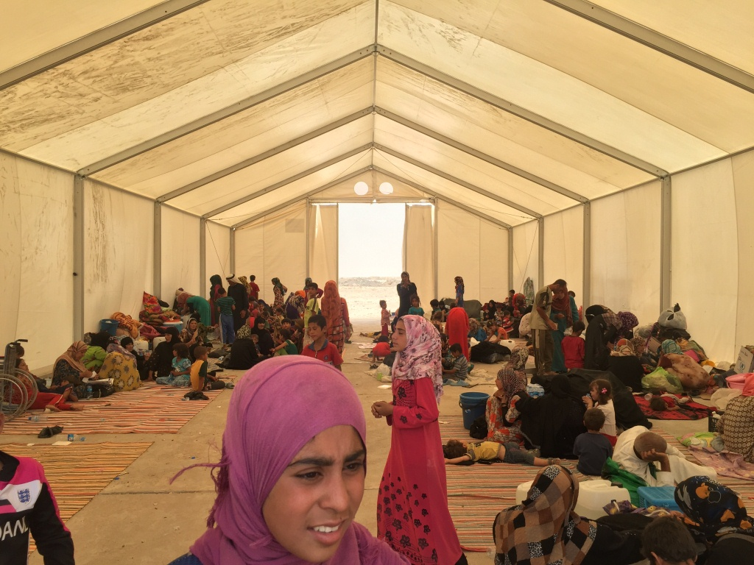
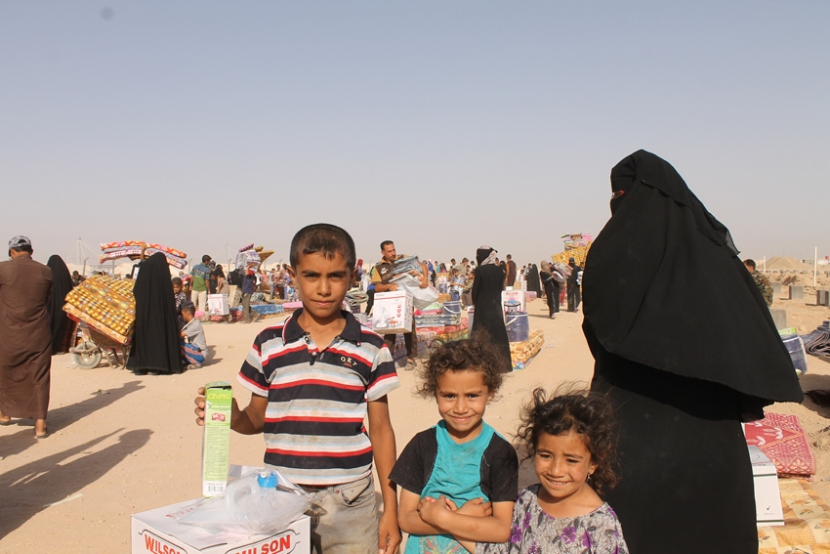
THANKS.
http://sheltercluster.org/response/iraq

