Slide 1
Shelter NFI Sector
Nigeria
Strategy and Technical Guidance
January 2016

Slide 2
Sector strategy and guidance
Harmonisation is beneficial:
To make our response more predictable
To ensure equity and conflict sensitive response
To inform budgeting, fundraising and procurement
To make consolidated procurement for cost and quality gains possible, if the sector chooses this
To start informing levels of cash transfer for the sector
Response should always should be based on assessment of specific needs, context and opportunities in each community
Sector strategy and guidance are LIVING DOCUMENTS, to be revised as necessary

Slide 3
Shelter NFI Sector Objectives
Humanitarian Response Plan 2016
objective 1:
Ensure sufficient and flexible supply and targeted delivery of minimum standard emergency shelter and NFI kits (including assessment, distribution and post-distribution monitoring) to people in need, including displaced people in host communities.
objective 2:
Deliver reinforced emergency shelter to upgrade and decongest formal and informal camps to minimum standards.
objective 3:
Deliver locally appropriate shelter solutions for vulnerable IDPs in need in host communities, and returning to their communities of origin.

Slide 4

Group | Targeting criteria | SHELTER Intervention | Estimate lifespan of intervention | Estimate cost per HH (materials only, USD) | Estimate HH, most vulnerable in need # | Sector Target #
Newly/secondarily displaced Fluid mobility, or land insecure | According to need | E-shelter kit =Cash/voucher | 6 - 12 months | 150.00 | 20,000 | 33,022
Transit Including cross-border | According to need | Communal shelter | (1-5 days stay) | 200.00 (ongoing use) | 5,000
Living with hosts | condition of shelter (overcrowding)/ vulnerability | E-shelter (local) Shelter repair =Cash/voucher | 6 – 12 months | 150.00 Insecure land and access | 119,000
 |  |  | 3 – 5 years | 450.00 Secure land and access | 10,000 | 7,000
Formal and informal camps existing and planned, land secure | condition of shelter/ vulnerability | Reinforced e-shelter Shelter repair =Cash/voucher |  | 450.00 | 16,000 | 8,000
Returnees to own land, in secure areas | condition of shelter (destroyed)/ vulnerability | Reinforced e-shelter Shelter repair =Cash/voucher |  | 450.00 | 30,000 | 6,000
Durable Solutions: Linkage with ERWG and UNDAF
Strategy: table beneficiary type, intervention, PiN, targets?
Notes:
Estimate cost is in italics as we are now to discuss the harmonised kit contents. This is what was used during the HRP. Note a variation of cost is expected for the reinforced emergency shelter – rural vs urban, etc.

Slide 5
Group | Targeting criteria | NFI Intervention | Estimate cost per HH (material only, USD) | Estimate people in need # | Sector Target #
Newly/secondarily displaced | According to need | Non-Food Items kit =Cash/voucher | 85.00 | 96,500 | 61,835
Transit | According to need
Living with hosts | Most vulnerable in need
Formal and informal camps | Most vulnerable in need
Returnees | Most vulnerable in need

Slide 6
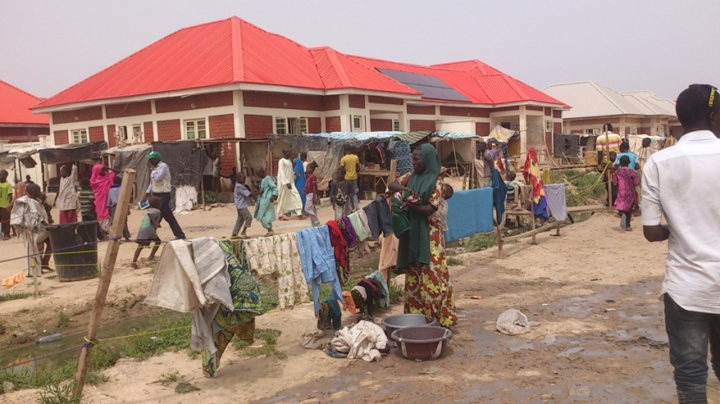
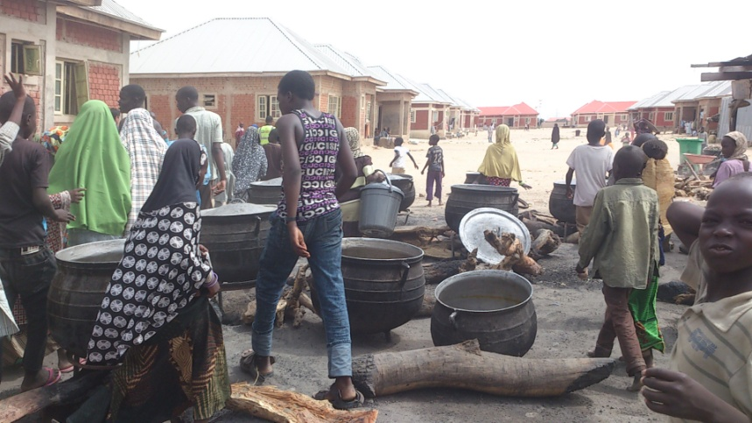
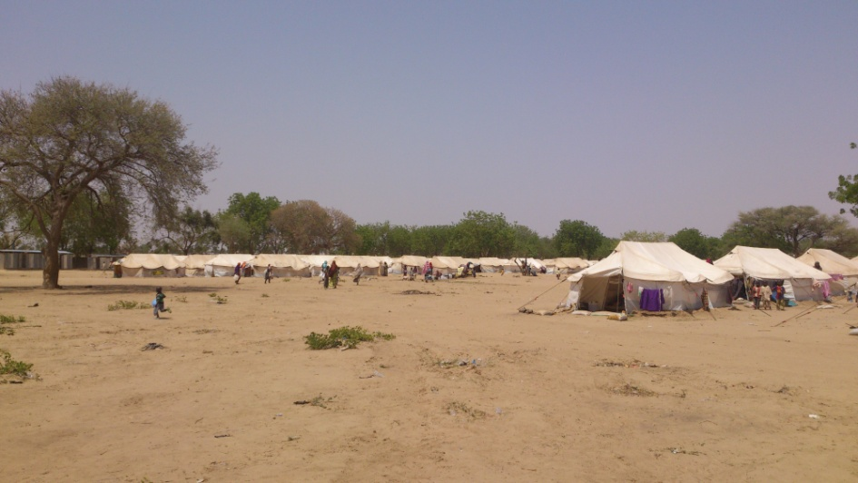
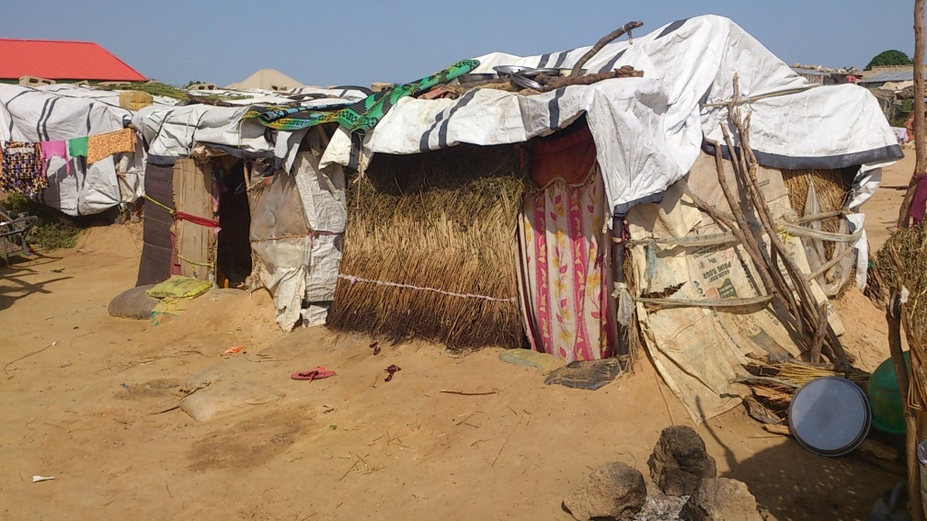
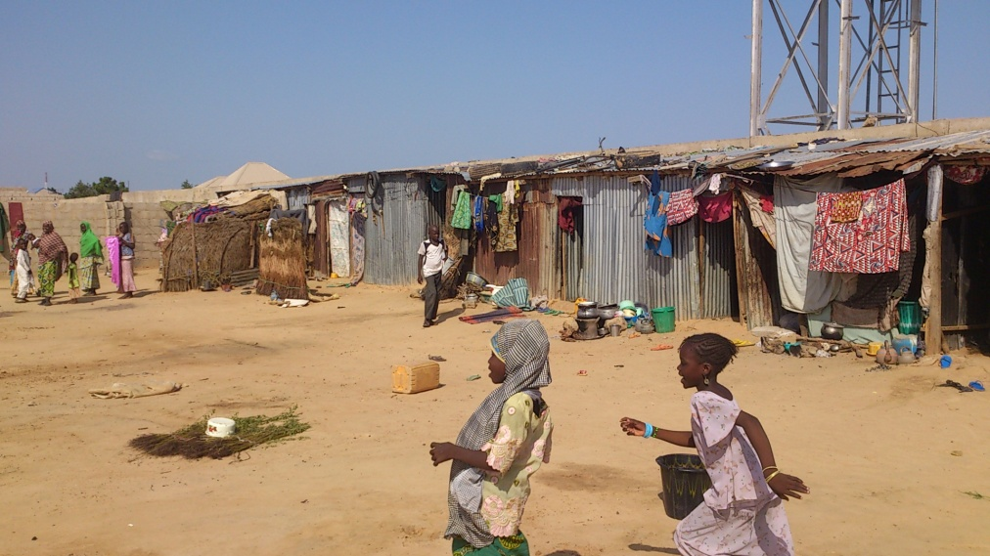
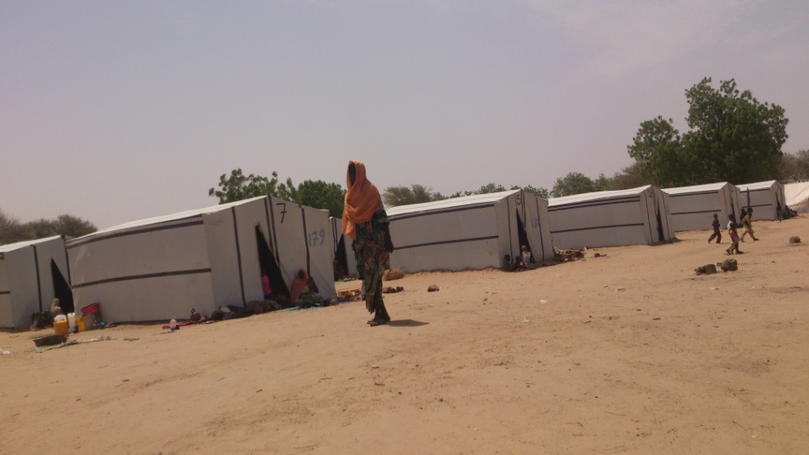
Maiduguri: decongestion and upgrade in formal and informal camps, and host communities

Slide 7
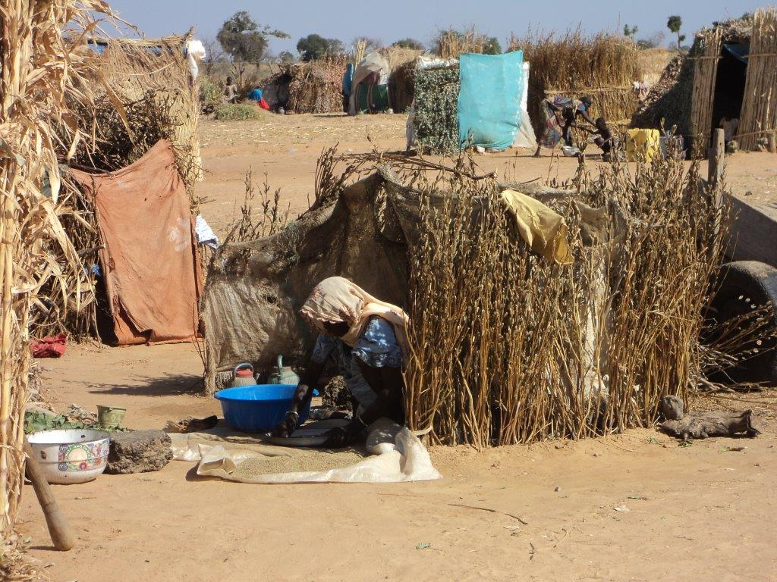
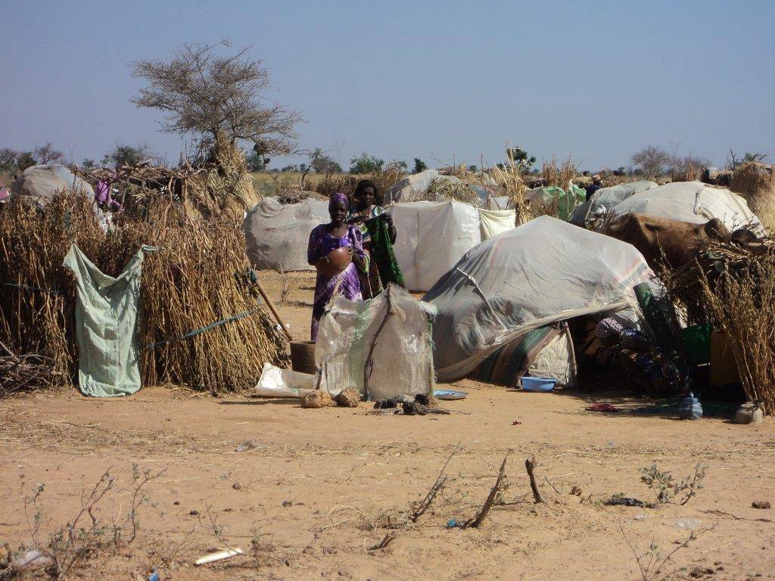
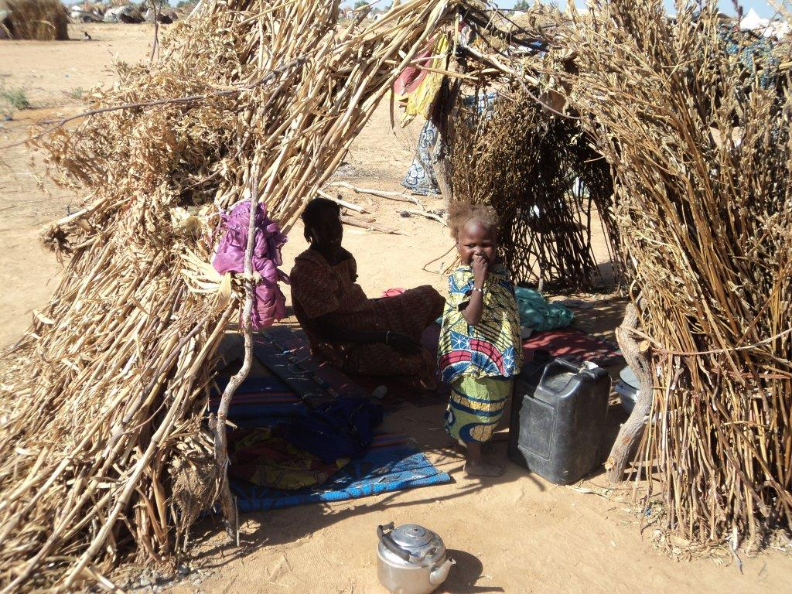
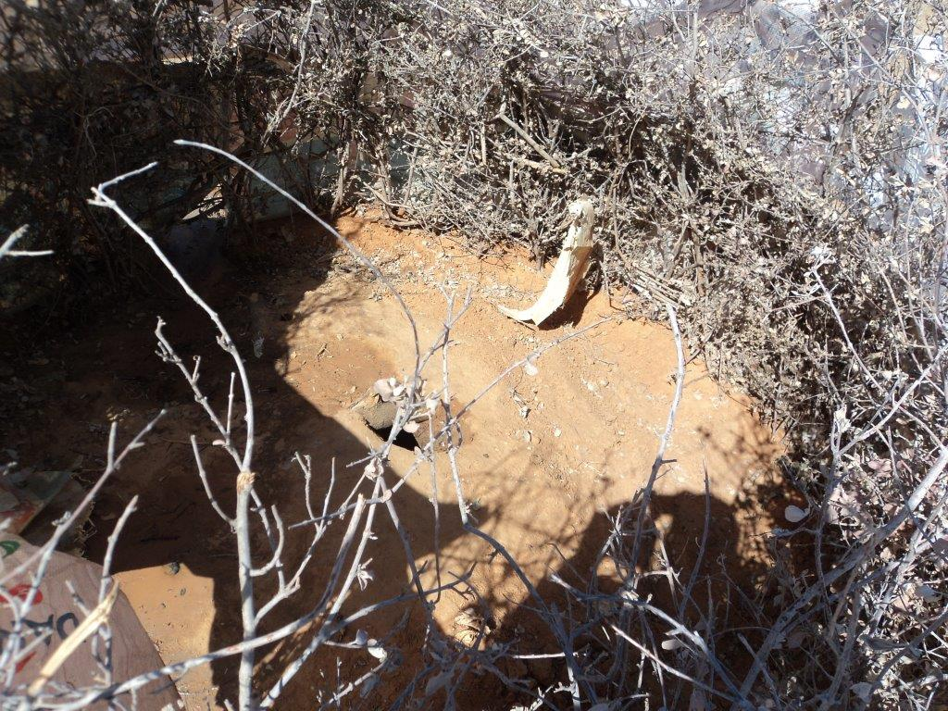
Kukurater informal camp, Damaturu: basic e-shelter (growth in informal camps in Yobe and elsewhere – DTM Round VI)

Slide 8
Response in host communities
Host community situation | Response
Living in the homes of others | -Reinforced e-shelter construction within family compounds (where land/tenure is secure and displacement likely prolonged) -Shelter repair within family compounds
Makeshift shelter on open land (usually privately owned) | -Reinforced e-shelter construction (where land/tenure is secure and displacement likely prolonged) -Basic e-shelter kit (where land is insecure, or movement anticipated)
Unfinished buildings (usually privately owned) | -Shelter repair (where land/tenure is secure, and displacement likely prolonged)
Renters | ?
As the sector moves shelter response into host communities, we need:
Harmonised approach to tenure and materials ownership negotiations with landowners
Agreement on how to define and allocate areas for partners to work (ward, or smaller designation?), and on approach to assessment/targeting (defining density, shelter condition, vulnerability)
Further assessment of extent and needs of renters
Notes:
Ask: is this correct? Which is priority? Who should own the materials (host family, landowner or IDPs to take away when they leave?) What area designations should we use (ward or smaller? Note this is linked to CCCM as we need to clarify what bounded areas within host communities will be assessed for the weekly multi-sector tool and out-of-camp support) Is anyone planning/able to contribute to developing this (eg approach to assessments; renting assessment; appropriate apprach to tenure/ownership – thinking of NRC here with their ICLA programme)

Slide 9
Key considerations
Urban vs rural: shelter response must be appropriate;
State variations: Adamawa – focus on host community and returns; Borno – focus on decongestion and upgrade of camps and host community in Maiduguri; Yobe – focus on upgrade in informal camps (which have been expanding in the last weeks);
Secondary displacements/sudden influx - continued fluidity of movement - will remain a possibility – the sector needs to retain ability for light and fast response at scale;
Unseen need (inaccessible areas) – large portions of Borno remain unseen – the sector needs to engage in discussions around access, and retain ability for light and fast response at scale.

Slide 10
NFI kit content
Minimum kit should be life-saving; appropriate to context; consider practicality (cost and scale)
Items selected for distribution must be based on assessment findings
 | Items | IOM | IMC | IRC | SCI | ACF | Mercy Corps | SEMA (Adamawa flood) | Proposed Quantity per HH
Kitchen set | Cooking pot 7L | 1 |  | 1 |  |  |  |  | 1
 | Cooking pot 5L | 1 |  | 1 |  |  |  |  | 1
 | Plates | 5 |  | 2 |  |  | 6 | 6 | 4
 | Cup | 5 |  | 2 |  |  | 6 | 6 | 4
 | Table Spoon | 5 |  | 4 |  |  | 6 | 6 | 4
 | Kitchen knife | 1 |  | 0 |  |  |  |  | 1
 | Service Spoon | 1 |  | 1 |  |  | 1 |  | 1
Sleeping | Matress |  |  |  |  |  | 3 | 1
 | Synthetic Sleeping Mats | 3 |  | 1 | 1 | 2 | 2 | 2 | 2
 | Blankets | 3 |  | 1 | 1 | 2 | 4 | 3 | 3
 | Mosquito nets |  |  |  | 2 | 2 |  | 3 | 3
 | Solar lights/flashlight?

Slide 11
 | Items | IOM | IMC | IRC | SCI | ACF | Mercy Corps | SEMA (Adamawa flood) | Proposed Quantity per HH
Water and hygiene | 20L Jerrican | 2 | 2 | 1 | 1 | 2 |  | 2 | 1
 | 10L Jerrican |  | 1 | 2
 | 20L Bucket |  | 2 | 1 |  |  |  | 2 | 1
 | 10L Bowl | 1 |  | 1
 | Kettle for hand washing | 1 | 1 | 1
 | Laundry soap (bars) | 7 | 4 | 10 | 3 | 7 |  |  | 7
 | Bathing Soap (250gms) | 7 | 4 | 10 |  | 7 |  |  | 7
 | Absorbent cloth for sanitary purpose (1x2m) reusable | 1 | 1 | 0 |  | 2 |  |  | 1
 | Aquatabs water purifier (sackets) |  | 250 | 0 |  | 105
Clothing | Length of cloth/kanga?
Packing |  | box |  |  |  |  | sack |  | 1

Slide 12
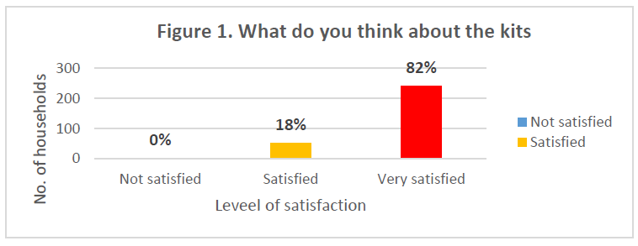
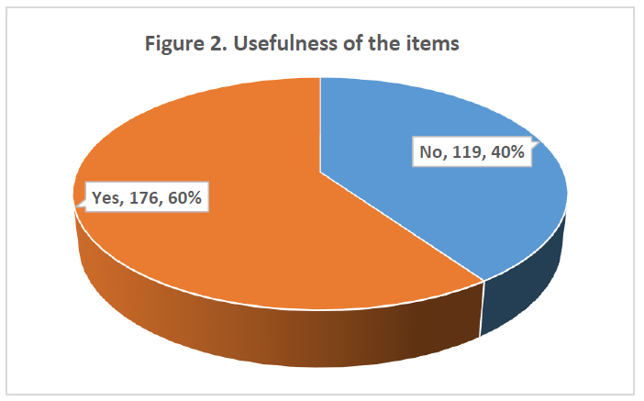
Respondents stated they would have found mattresses, clothes, medicine, cash and food more useful.
- ACF, Post-Distribution Monitoring Report, Yobe, September 2015
Notes:
Ask: which are priority NFI? Does anyone have PDMs or other evaluation of NFI response to date that we haven’t seen? Note we intend to conduct further community consultation before finalising: ask if anyone willing/able to contribute to this.

Slide 13
Basic Emergency Shelter
For use when land use or access is insecure, and/or movement likely to remain fluid
Distributions of basic material kits (plastic sheets, rope, poles) and tools to provide essential protection from the elements
Basic emergency shelter will remain the core element of the emergency shelter response, considering scale, cost and access
Items selected for distribution must be based on assessment findings
Shelter Repair
- For use in host communities, where shelter is inadequate. Items specific to shelter repair needs to be based on detailed assessment. Technical support to be provided.

Slide 14
Items | IOM | ACF | Proposed quantity per HH
Plastic sheet (size 4mx5m), 4kg | 2 | 2 | 2
Rope (10mm with 20 meter long) | 1 | 1 | 1
Tie/Galvanized Wire (1.5mm diameter, 25m long) | 1 |  | 1
Umbrella nails (75x3.6mm, head diameter 20mm, thickness 2mm) | 1
Iron Nails no.2 (kg) | 1
Iron Nails no.3 (kg) | 1
Shovels (round pt with Y handle presses carbon steel) | 1 |  | 1
Claw hammer (high carbon steel head with claw and flat side) | 1
Craw bar (one and half inch diameter with chisel end) | 1 |  | 1
Handsaw (18” – 20”) | 1 |  | 1
PVC pail No. 12 | 1
Lumber poles | 6 |  | 6

Slide 15
Reinforced Emergency Shelter
Formal and informal camps and host communities
In camps and host communities, where land use is secure, and displacement in-situ is likely to continue
To include construction/technical support as well as materials
Up-front investment in decongestion and upgrade creating savings down the line
Rural and urban variations
People-centred design; climate considerations
Rural designs must be based on local materials and production as far as possible
Community participation/contribution to be sought wherever possible
Target severe overcrowding and inadequate shelter condition
Return
In return settings, on land owned by beneficiary
Must take into account cultural factors: use of separate shelters for zauri and sleeping rooms, so that materials provided form the basis for recovery
Target destroyed homes

Slide 16
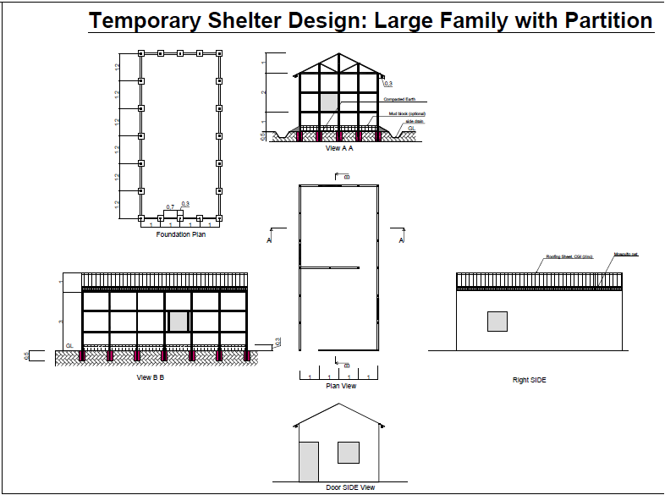
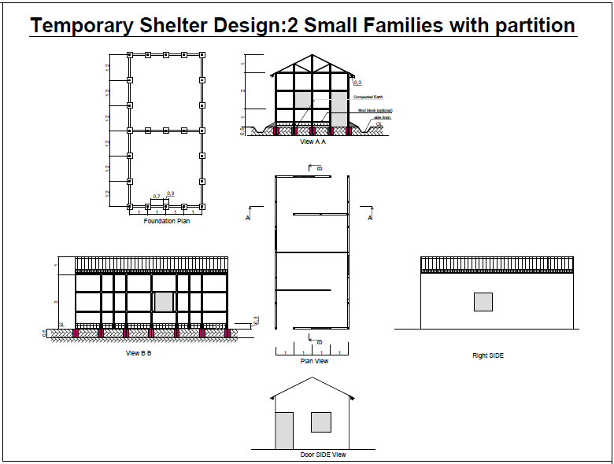
URBAN Reinforced Emergency Shelter
Example: Maiduguri Working Group, Bakassi design

Slide 17
Specification | Unit | Quantity | Unit cost (NGN) | Total cost (NGN) | Total cost (USD)
Timber 4”x2”x12’ hard wood (iron wood) | Pcs | 72 | 520 | 37,440 | 187
Timber 2”x2”x12’ hard wood (iron wood) | Pcs | 20 | 350 | 7,000 | 35
Timber 1”x4”x12’ hard wood (iron wood) | Pcs | 8 | 500 | 4,000 | 20
CGI ( Zinc) Roofing - 3’x10’ | Pcs | 18 | 750 | 13,500 | 68
GI sheet 1’x10’ | Pcs | 3 | 600 | 1,800 | 9
Straw under CGIs | Pcs | 0 | 0 | 0 | 0
mosquito net | m2 | 11 | 350 | 3,955 | 20
4" nail | kg | 10 | 230 | 2,300 | 12
3" nail | kg | 3 | 230 | 690 | 3
2" nail | kg | 1 | 230 | 230 | 1
Roofing nail, in 7kg pack | Pack | 2 | 1,500 | 3,000 | 15
4" hinges for doors and windows | Pcs | 10 | 200 | 2,000 | 10
Reinforced tarpauline 4x5m | Pcs | 5 | 6,000 | 30,000 | 150
Total materials |  |  |  | 105,915 | 530
Labour (20%) |  |  |  | 21183 | 105.915
Total shelter cost for 1 family ≥8 persons |  |  |  | 127,098 | 635

Slide 18
Specifications
Guidance: IOM, IFRC global specifications
Local procurement versus quality? (plastic sheeting; CGI)
Local procurement versus market impact? (regional market assessment planned for January)
Consolidated procurement for cost effectiveness?
Notes:
Share IOM specs. Note CGI and plastic sheeting locally is generally of lower standard; do we want to accept this? NRC and IOM discussing import of plastic sheeting, this may be the way to go for that in any case; local agreement made on CGI to accept the 20 gauge. Ask about quality control in place? Note the regional assessment is food based but we are encouraging shelter/NFI to be included as well as it can inform our operation. It’s WFP/NRC/ACF so far.

Slide 19
Information Management
Tool | Frequency | Responsible | Format | Purpose
Response reporting (assessment, PDM reports) | Ad hoc, as response is delivered | Delivering agency | Agency specific | Tracking coverage and approach, sharing lessons learned
E-Shelter NFI distribution report | Monthly | Delivering agency | Sector format | Tracking sector delivery and plans
CCCM Multi-sector report | Weekly | Designated CCCM agency for site | Sector format

